Slide 1
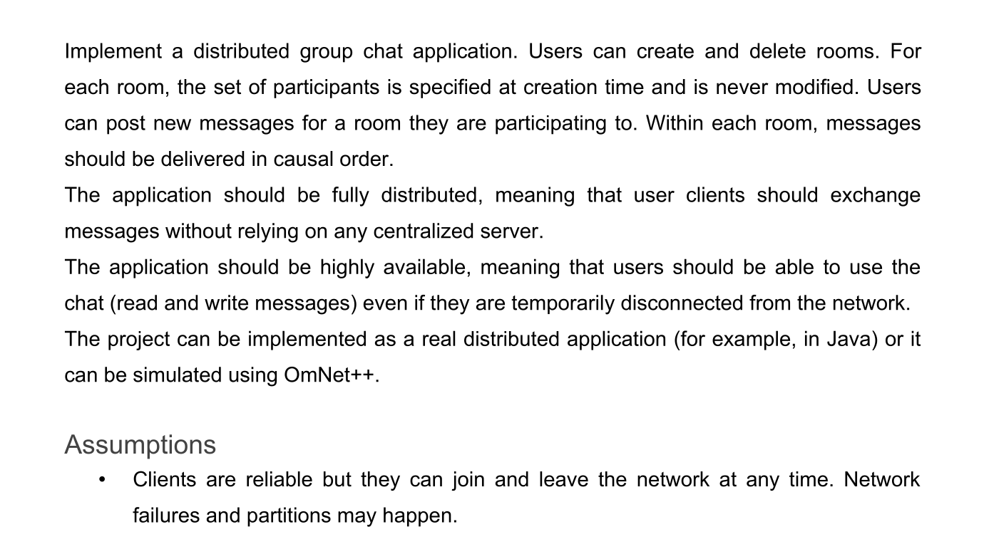

Slide 2
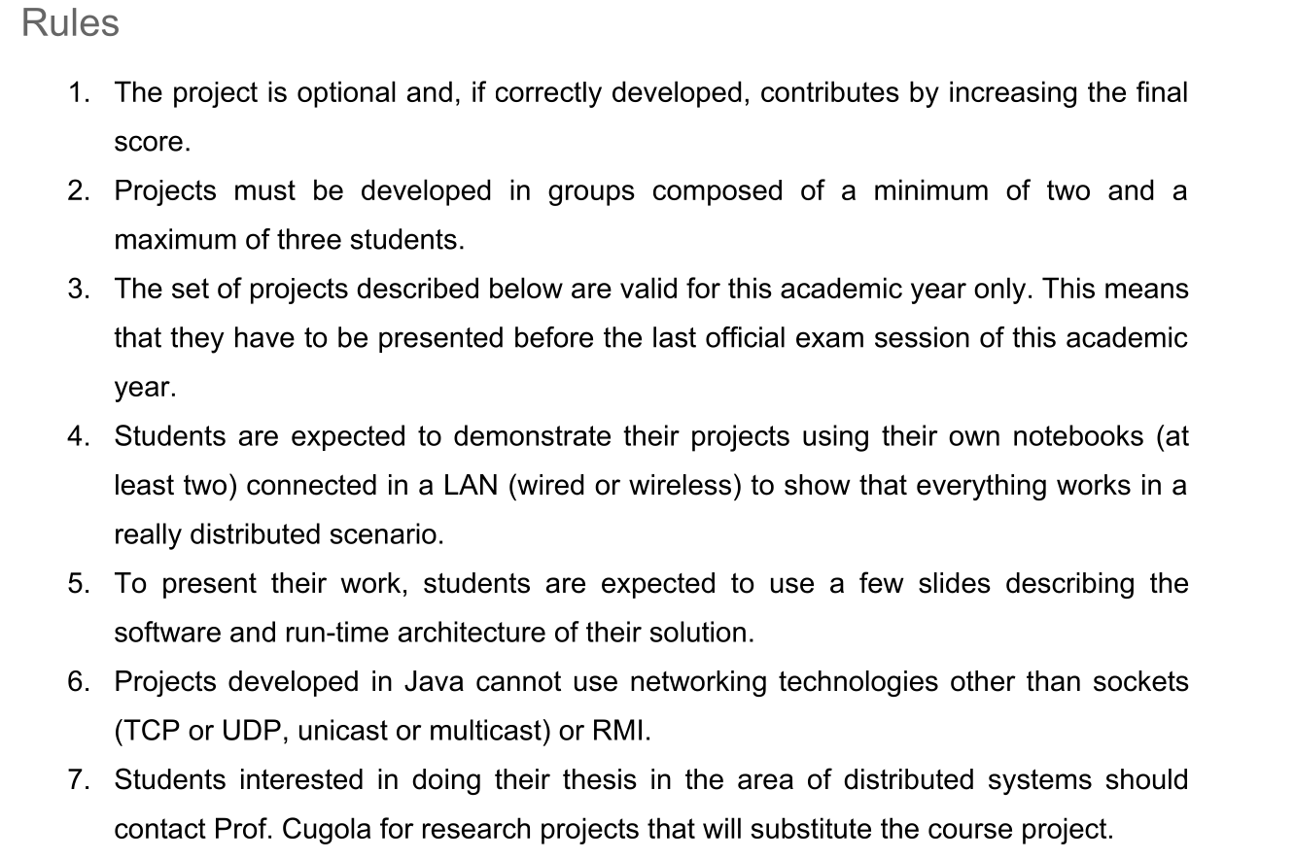

Slide 3
Highly available, causally ordered group chat

Slide 4
Project requirements
Distributed chat application
A user can create a room specifying a non mutable participants list
The user who created the room can delete it
Every user inside a room can post messages
Messages should be delivered in causal order
Users can use the chat even if they are temporarily disconnected

Slide 5
Implementation
To simulate this scenario we used Omnet++
To achieve the requirement of messages causality we implemented a protocol based on vector clocks.
High availability is guaranteed by allowing each client to ask for missing messages to every client being part of the room.

Slide 6
Handling missing packets
In case a client (due to a network partition, low time to live, ecc…) doesn't get a message he needs he can request it to other clients with an AskMessages packet.
Every client in possession of that message can then send that message to the requester.
In case a room gets created and the room creation message gets lost the admin of the room will continue to send the message until eventually the client will answer with an ack message.
In case of room deletion message miss the client can receive it from any client when asking for messages.

Slide 7
Network partitions
In our simulation a network partition can occur.
We cut communication for a random set of gates and after t time the communication gets restored.

Slide 8
Testing
In order to test that our simulations achieves its requirements we had to test for consistency.
We used a complementary Python 3 script that parses simulation output and checks for:
Causality (If a message gets displayed by a client, such client must also have already displayed every message the sender has seen before sending that message)
Every message gets delivered to every client in the room and only to those clients.

Slide 9
Testing (scenarios)
We created three different network topologies to test that our clients can work under different network circumstances.
Ring with 5, 10 and 50 clients
Fully Connected with 5, 10 and 50 clients
Tree with 5, 10 and 50 clients
With events timing specified in Network.ned and omnetpp.ini.
Each simulation with more repetitions.

Slide 10
Testing (scenarios) - events for repetitions 0
 | num partitions | num rooms | messages | max messages in a room
Ring - 5 | 42 | 44 | 1200 | 29
Ring - 10 | 45 | 76 | 5489 | 80
Ring - 50 | 2 | 29 | 4356 | 20
Fully - 5 | 42 | 51 | 1233 | 46
Fully 10 | 45 | 80 | 5427 | 38
Fully - 50 | 3 | 26 | 2658 | 26
Tree - 5 | 41 | 41 | 1250 | 88
Tree - 10 | 37 | 86 | 4942 | 39
Tree - 50 | 2 | 23 | 5685 | 40

Slide 11
Demo

